Slide 1

Group Members :
Project Id : FYP19PID16
2019-CS-224 Muhammad Ali Mazhar Butt (Group Leader)
2019-CS-246 Abdullah Rasheed
2019-CS-207 Maham Wajid
2019-CS-218 Ehtesham Haider

Slide 2
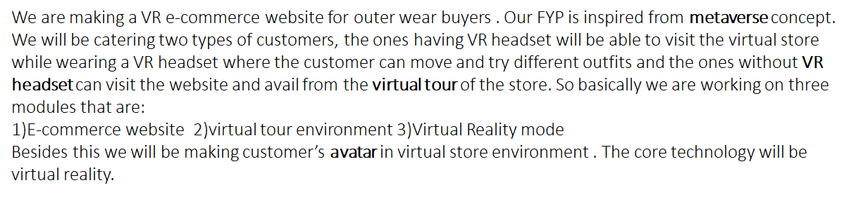
Title :
Virtual Reality based E-Commerce Web Application
Application Name :
Metaverse Mart
Description :

Slide 3
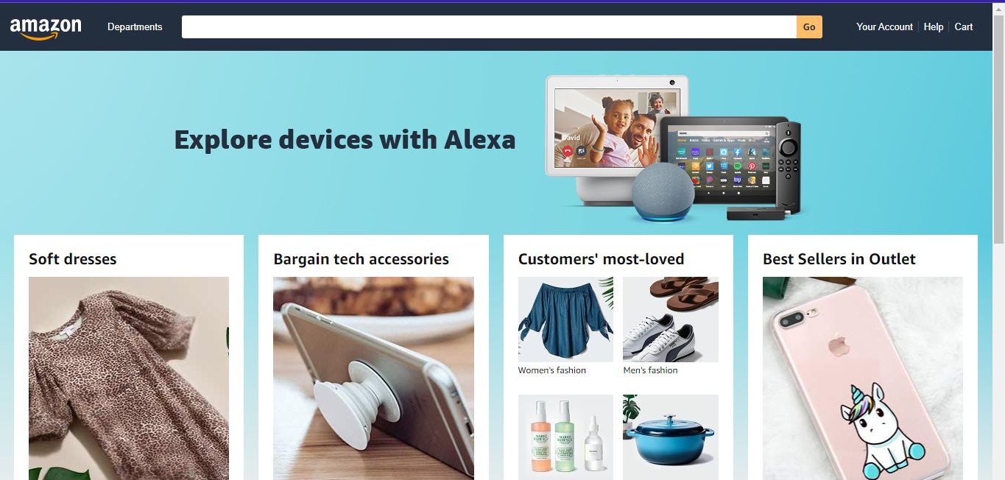

Slide 4
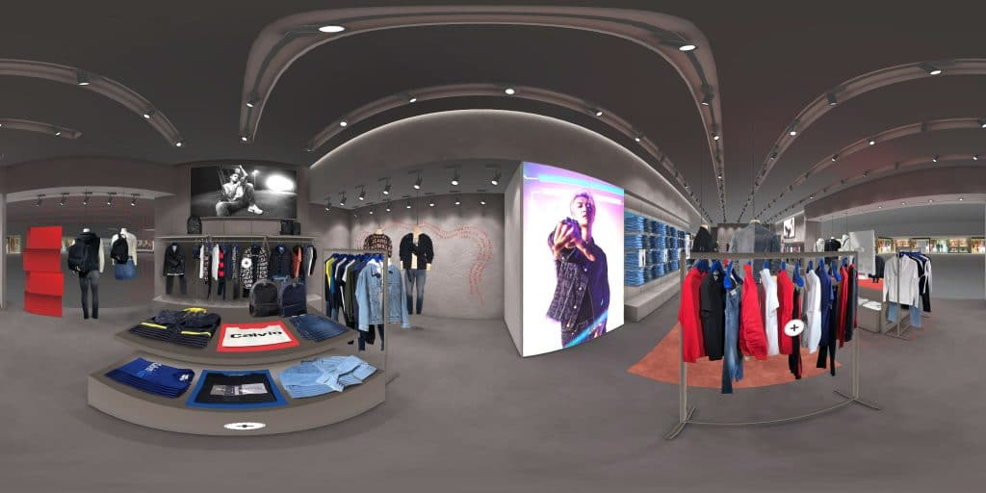
3D Tour of Ecommerce Store

Slide 5



Slide 6
Documentation
Literature Survey
Feasibility Study
Functional & Non Functional Requirements
User Stories
Acceptance Criteria for user stories
Test Case Scenario

Slide 7
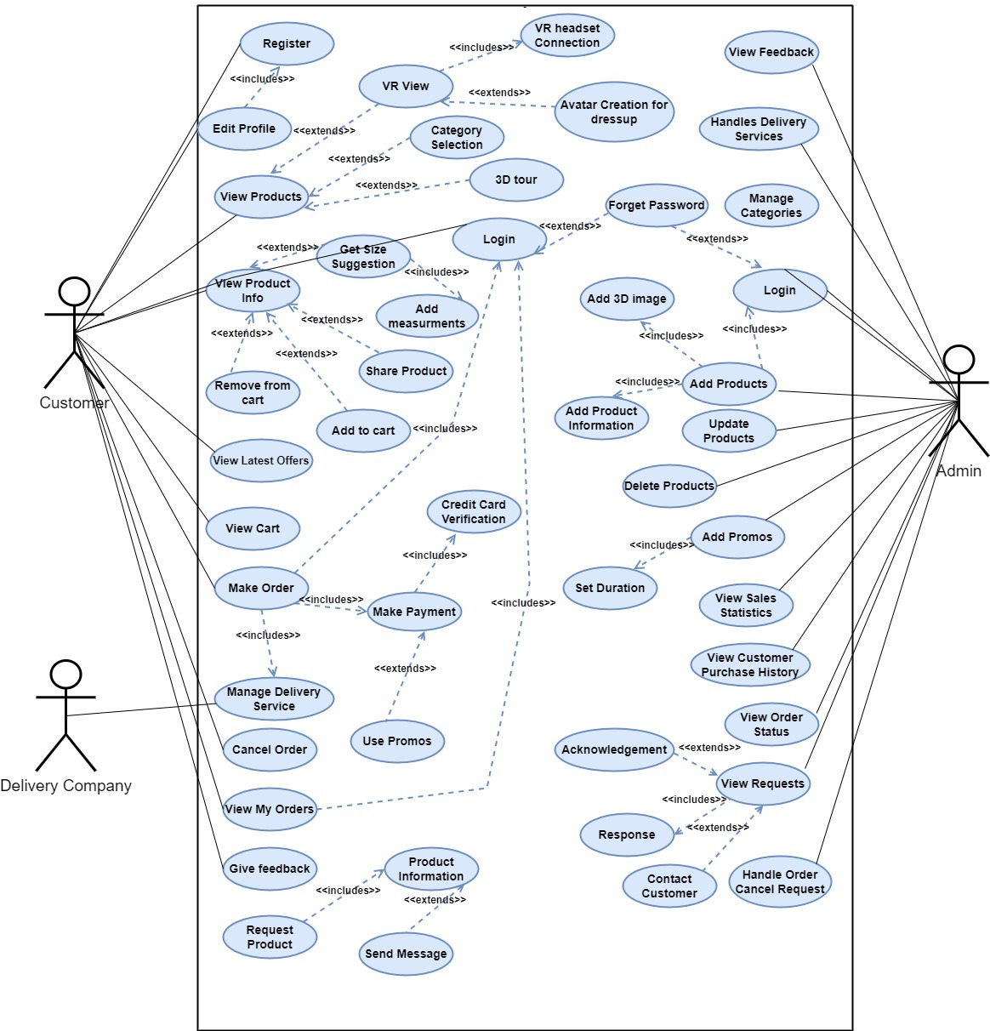
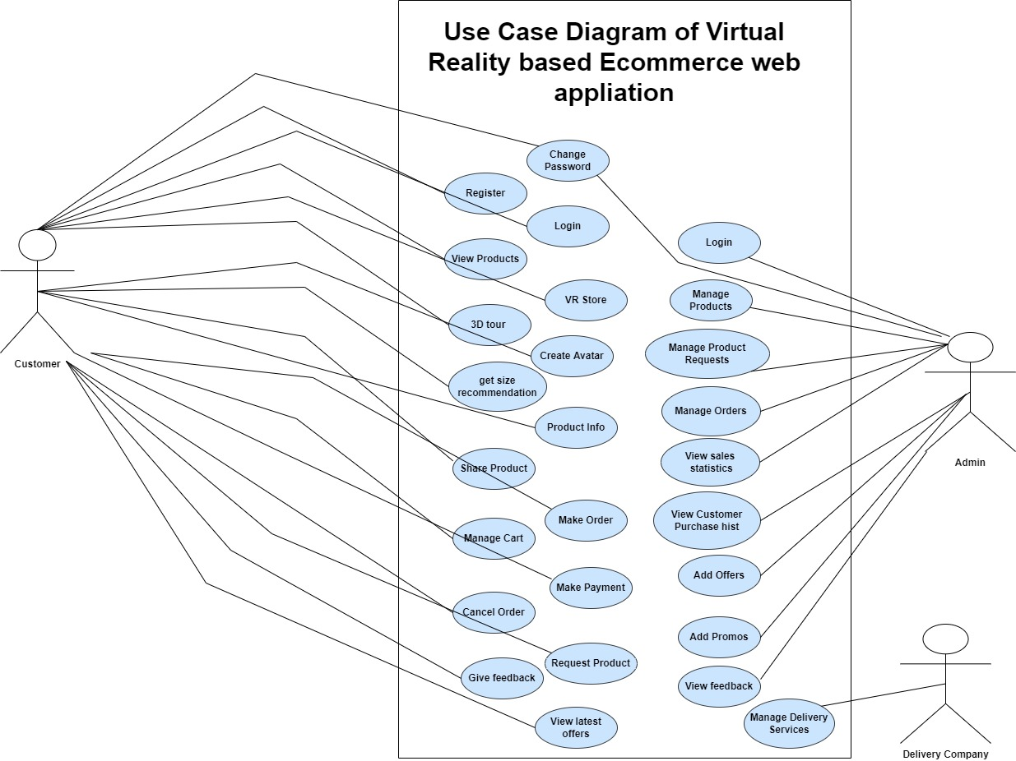

Slide 8
Key Performance Indicator :
We will commercialize our application. The metrics formulas and application KPIs that will help us to measure the impact of the hard work we put in to develop our audience are Customer Retention Rate, Revenue growth, Profit margin, Customer satisfaction, and Average order value.

Slide 9
Thank You

